Slide 1

Quantitative Emotion Prediction of Texts in Valence and Arousal Space from Microblog Data
Student: Shi Jinping (師晉平)
Advisor: Prof. Yi-Shin Chen
Institute of Information Systems and Applications,
National Tsing Hua University
Notes:
Good afternoon
Thank you for attending my oral defense
My oral defense topic is Quantified Emotion Prediction of Texts in Valence and Arousal Space from Microblog Data

Slide 2
Outline
Introduction
Related Work
Objective
Methodology
Experiment and Evaluation
Conclusions
Notes:
I will present my research by the following outline

Slide 3
Outline
Introduction
Related Work
Objective
Methodology
Experiment and Evaluation
Conclusions
Notes:
Now let’s start with the first part
I will introduce the background of the research

Slide 4






Introduction
?
Basically, there are two different types of text emotion detection
Notes:
Nowadays people like to express their feelings on social media, like Facebook and twitter. And we would like to detect the emotion they express through their posts.
But how to detect the emotion of text?
Basically, there are two different ways of text emotion detection

Slide 5
Related Work
Determinative Classification
{negative, neutral, positive} or {Anger, Disgust, Fear, Joy, Sadness, Surprise}
Shiyang W. etc., Emotion Classification in Microblog Texts Using Class Sequential Rules, 2014
Maria etc., Sentiment Polarity Detection in Spanish Reviews Combining Supervised and Unsupervised approaches, 2013
Mass etc., Learning word vectors for sentiment analysis, 2011
Yoon, Convolutional Neural Networks for Sentence Classification, 2014
Naïve Bayes
Support Vector Machine (SVM)
Random Forest
Convolutional Neural Networks (CNN)
Recurrent Neural Network (RNN)
Classifies text into a discrete emotion candidates set
Generally one emotion or finite emotions are detected
Notes:
The first one is determinative classification. By using this method, we can classify a text into negative or positive, or more specifically, into anger or joy.
This method is very popular among researchers. Many work have been done by using various classification methods, like naïve Bayes, SVM, and recently, many researchers have applied CNN and RNN on text emotion classification.
Basically, no matter what methods are used, determinative classification mainly classifies text into a discrete emotion candidates set. So generally, only one emotion or finite emotions are detected.

Slide 6
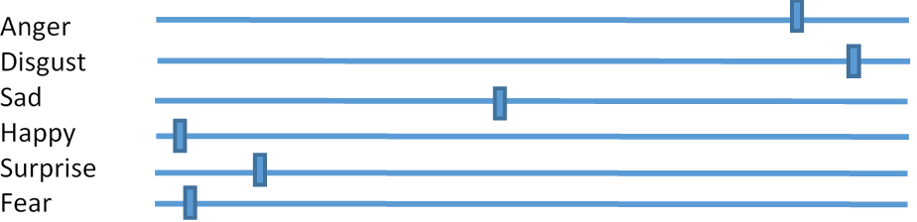

Related Work
Surprise
Joy
Anticipation
Anger
Sadness
Disgust
Thanks for the birthday wishes everyone!!!
Surprise
Joy
Joy
Anticipation
Anger
Sadness
Disgust
Surprise
Joy
Anticipation
Anger
Sadness
Disgust
[Argueta, Carlos etc., 2015]
Notes:
To employ the supervised approach, we need to label the data.
We could let annotators to label the given text. We can choose the answer that the majority have chosen as the final answer.

Slide 7
Related Work
Anger
0.01
Surprise
Joy
Anticipation
Anger
Disgust
0.00
Sadness
Disgust
Thanks for the birthday wishes everyone!!!
Surprise
Sadness
0.01
Joy
Anticipation
Anger
Joy
0.50
Sadness
Disgust
Surprise
Anticipation
0.10
Joy
Anticipation
Anger
Surprise
0.38
Sadness
Disgust
Not easy for laymen (annotators) to conceptualize affects
Inter-relationships among emotions are not clear
What if Anger = Disgust = Sadness = Happy = Fear = Surprise = 1/6 ?
[Argueta, Carlos etc., 2015]
Notes:
Or, we could let annotators assign a weight to each emotion candidate. So we could get more information about the text.
But, this method is not very friendly to annotators. Because most of the annotators lack professional background. They may have difficulty in assigning a specific emotion to the text.
In addition, the inter-relationship among emotions are not clear. For example, what if the weight of each emotion is equal. It hard to make a decision.

Slide 8
Related Work
Determinative Classification
{negative, neutral, positive} or {Anger, Disgust, Fear, Joy, Sadness, Surprise}
Naïve Bayes
Support Vector Machine (SVM)
Random Forest
Convolutional Neural Networks (CNN)
Recurrent Neural Network (RNN)
Classifies text into a discrete emotion candidates set
Generally one emotion or finite emotions are detected
Notes:
Traditional emotion detection classifies text into negative, neutral and positive set, or more specifically, into anger, disgust, fear, joy, sadness and surprise discrete emotion candidates set.
There are many approaches to achieve this emotion classification, like Naïve Bayes, random forest, and so on. Most of these methods are using bag-of-word model, that is they are using words count or tfidf as features.

Slide 9
Related Work
Regression
(based on VA Emotion Model)
Valence (x-axis):
the pleasantness of a stimulus, also referring to as sentiment
Arousal (y-axis):
intensity of emotion provoked by a stimulus
Valence and arousal space (VA-space)
It is numerical, thus regression approaches are generally used
Continuous, and natural for annotators to rate
Russell James A. A circumplex model of affect.Journal of Personality and Social Psychology, pages 1161–1178, 1980
Notes:
So some researchers tend to use other methods to extract emotions from text. They define an emotion in a two dimensional continuous space. The first dimension is called valence. It is the pleasantness of a stimulus and also called sentiment. The other dimension is arousal. We can treat it as the intensity of emotion provoked by a stimulus.
So this space is also called VA space and this emotion model is also called VA emotion model. We can see that it is numerical and continuous, therefore, we often use regression approaches to extract text emotions.
And besides, it is natural for annotators to rate because compared to determinative classification, this method asks users to evaluate current emotional status instead of understanding the emotion concept.

Slide 10
Related Work
Linear and Non-linear Regression
Daniel. etc., Modelling Valence and Arousal in Facebook Posts, 2016
Georgios Paltoglou and Michael Thelwall. Seeing stars of valence and arousal in blog posts. IEEE Transactions on Affective Computing, 4(1):116–123, 2013
Graph Based
Jin W. etc., Community-Based Weighted Graph Model for Valence-Arousal Prediction of Affective Words, 2016
Probabilistic Model
Ju-Chiang Wang, etc. Modeling the affective content of music with a gaussian mixture model. IEEE Transactions on Affective Computing, 6(1):56–68, 2015
Sicheng Zhao, etc. Predicting continuous probability distribution of image emotions in valence-arousal space. pages 879–882. ACM, 2015
Notes:
Many work have been done based on this VA emotion model.
Some researchers used linear or non-linear regression to predict the VA values of texts
Some researchers applied graph theory to infer unseen text emotion in VA space.
in addition, VA emotion model is also used in other fields. Some researchers proposed probabilistic model to get the distribution of emotion of music or images.

Slide 11
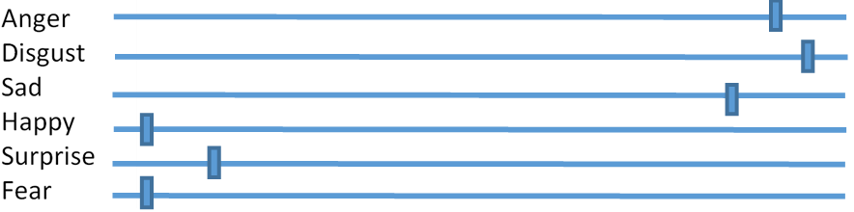
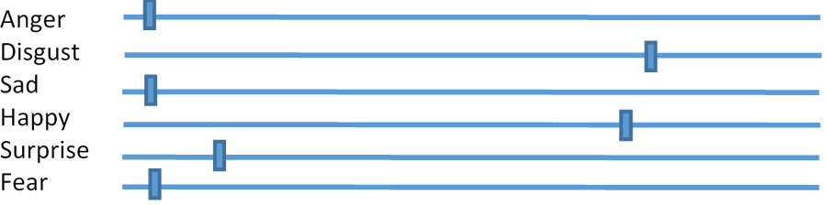
Related Work
To label or verify the emotion of a text (another alternative)
Anger
0.23
Disgust
0.55
Stop it!
It’s not funny!
Sadness
0.18
Happy
0.01
Fear
0.02
Surprise
0.01
Notes:
Thus, we can let annotators give a weight to each emotion. Then we are able to know the proportion of each emotion for the given text

Slide 12
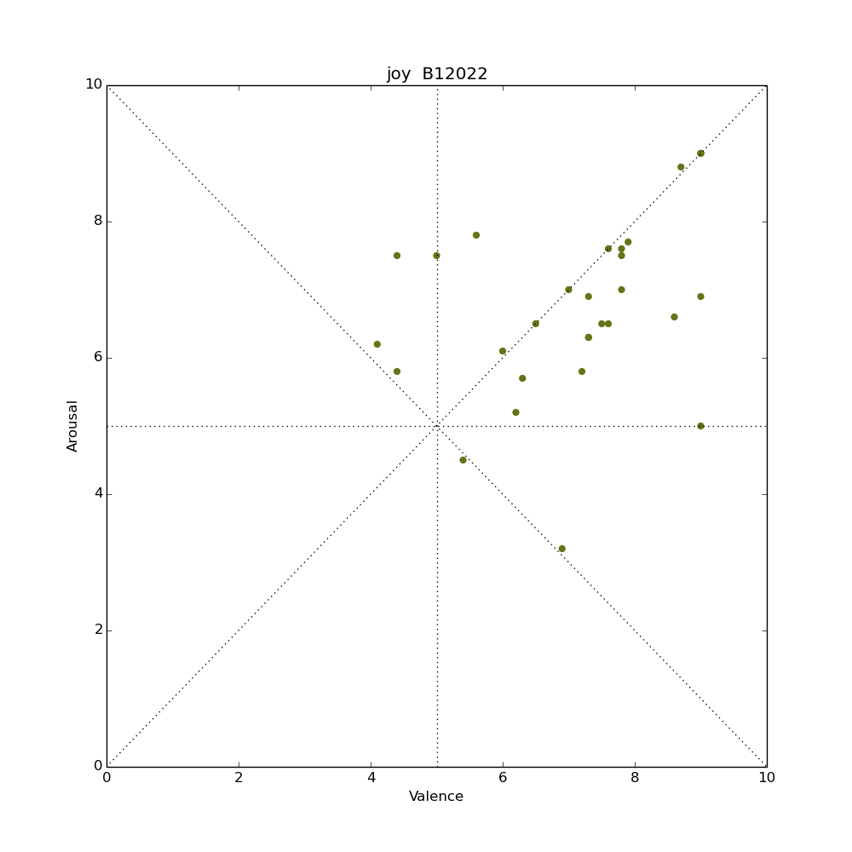
Related Work
Emotions Defined in VA-Space
Daniel. etc., Modelling Valence and Arousal in Facebook Posts, 2016
Jin W. etc., Community-Based Weighted Graph Model for Valence-Arousal Prediction of Affective Words, 2016
Emotion has valence and arousal values (VA values)
Intuitively displays the relationship among emotions
It naturally combines different emotions
VA-space
Notes:
The emotion defined in VA-space is denoted as (v,a), like a coordinate representation
If we define emotion in VA space, how do we detect emotions of a giventext

Slide 13
Related Work
Stop it! It’s not funny!
Arousal
Arousal
Expected location
causes bias
Valence
words lack VA values
Valence
Jin W. etc., Community-Based Weighted Graph Model for Valence-Arousal Prediction of Affective Words, 2016
Notes:
To detect emotion in VA space, we need to label data as well.
We could rate the words of a sentence and then take the average as the VA values of the whole sentence.
However, it may cause bias because it does not consider the context. And in addition, some words may lack VA values.

Slide 14
Related Work
Arousal
Arousal
Stop it!
It’s not funny!
Rating
Average
Valence
Valence
VA ratings
Only provides the location of the text in VA space
How accurate the location is?
Variance ratings
Daniel. etc., Modelling Valence and Arousal in Facebook Posts, 2016
Notes:
Alternatively, we can rate the whole sentence rather than words.
But, it only provides the location of the text in VA space. And as we can see, because different annotators may have different feelings to the same text, even for the same emotion, they may have different ratings. So the VA ratings may be in big variance.

Slide 15
Related Work
Determinative Classifications
have difficulty in detecting ambiguous
People are not certain to measure the status
cannot reveal the relationship among possible emotions
Regression Approaches
naturally for people to rate
cause variance ratings
in word-level based, have bias
Notes:
To avoid the biasness, we can asked annotators to rate the VA values of the whole text, then average the ratings as the emotion as the text. It is more reasonable than the word-level averaging.
However, it still has some drawbacks.
It only provides the location of the text in VA space. It is also influenced by outliers. And we can see, the possible emotions are not used.

Slide 16
Objectives
Our Method – EmoPredictor: A Probabilistic Model
Integrates determinative classification into VA emotion model
Instead of obtaining a specific emotion or exact values in VA-space, for a given statement,
we provide the emotion distribution in VA space
Arousal
Thanks for the birthday wishes everyone!!!
Valence
Notes:
So, in our research, we propose a probabilistic model, called EmoPredictor, to extract the emotions from text
This model integrates determinative classification into VA emotion model, which avoids the drawbacks of both numerical emotion extraction and determinative classification.
We don’t assign a specific emotion to the text or provide exact values in VA space, instead, for a given statement, we provide the emotion distribution in VA space.

Slide 17
Outline
Introduction
Related Work
Objective
Methodology
Overview
Framework
EmoPredictor Modeling
Experiment
Conclusion
Notes:
Next, I will present the methodology of our approach.

Slide 18
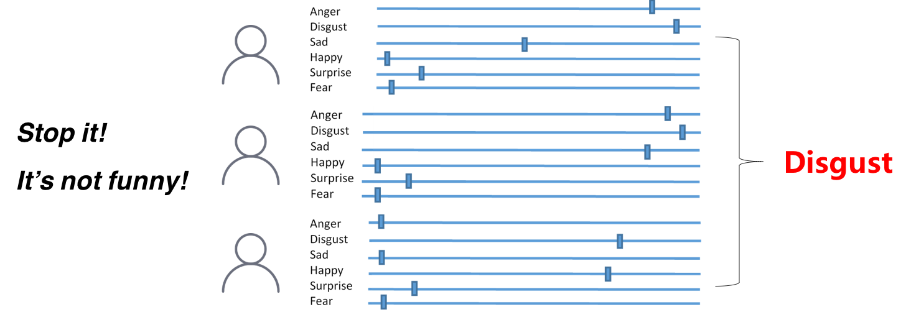
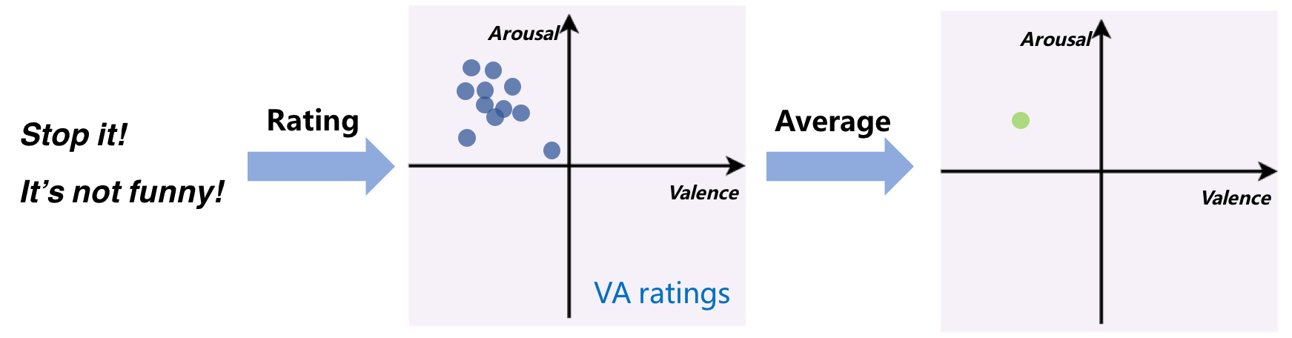
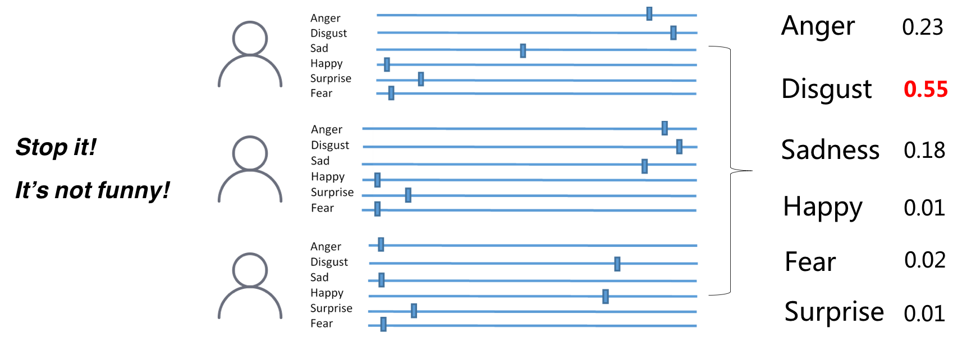
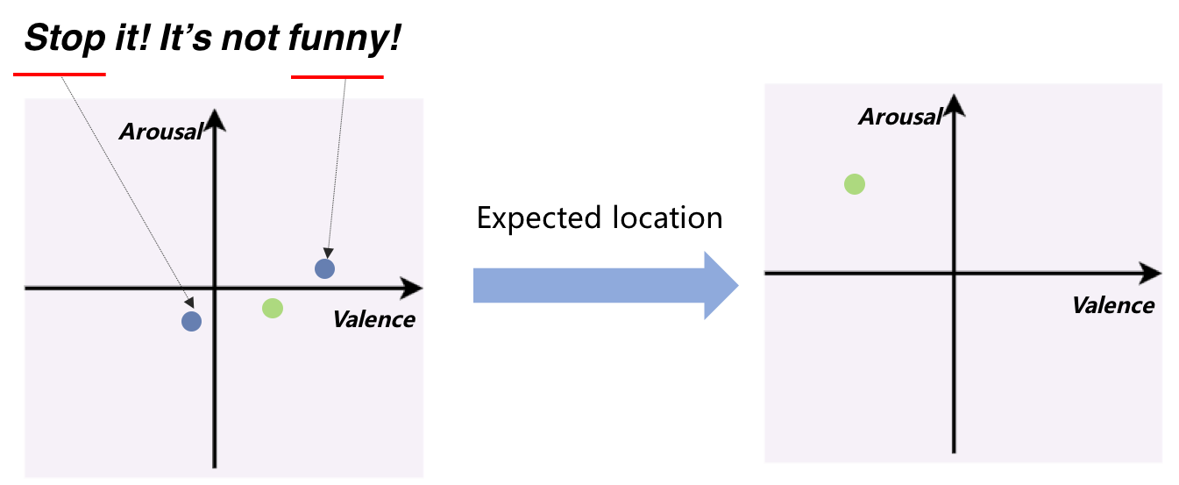
Assumptions
Most of the work follows or implies the following assumptions:
Different users have different emotion perceptions towards the same text, but lead to a certain distribution
The text emotion consists of multi-emotions rather than a single emotion
Notes:
We can see from the above examples, most of the work follow or imply the following assumptions.
First, different users have different emotion perception towards the same text, but lead to a certain distribution
Second, the text emotion consists of multi-emotions rather than a single emotion

Slide 19
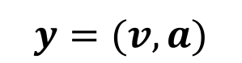
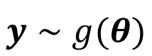
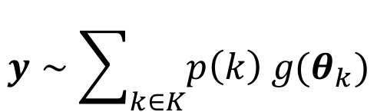
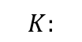
Methodology – Assumptions
Different users have different quantified perceptions toward the same emotion, but the perceptions converge to a certain distribution.
For a single emotion of a text :
$$y=(v,a)$$
For the emotion distribution of a text:
$$y∼g(θ)$$
The text emotion consists of multi-emotions rather than a single emotion
$$y∼\sum_{k∈K}{p\left(k\right) g(θ_{k})}$$
Mixture Model
$$K:$$
possible emotion set
Linear combination of |K| emotions with corresponding emotion proba. $p(k)$
Notes:
Let’s first look at the assumptions.
Actually, most of the work I introduced just now follows or implies the following assumption. The first one…
This just corresponds to the previous example that we taking average of the weight of each emotion and we choose the emotion that the majority chose
So we first denote valence values as bold v and arousal values as bold a. Let y = (v,a), representing the emotion of texts. Then we can use g(\theta) to represent the emotion distribution. \theta is the parameters of this distribution.
Second, the text emotion consists of multi-emotions rather than a single emotion. Suppose the text emotion contains possible K emotions, we can simply combine them linearly with p(k) as each emotion’s weight.
So the text emotion distribution, we can treat it as the linear combination of K emotions with corresponding emotion probability p(k)
This is also called Mixture Model.

Slide 20
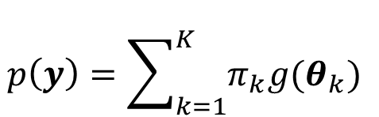
Methodology – Overview
Define Mixture Model
$$p\left(y\right)=\sum_{k=1}^{K}{π_{k}g(θ_{k}) }$$
Distribution determined by VA ratings
Criteria:
$g(θ_{k})$ is able to represent the rating patterns
Mardia’s Test: Multivariate Normal Distribution Test
72% of the VA ratings passed Mardia’s Test
VA ratings of a text can be treated as a bivariate normal distribution
$p(y)$ is able to approximate most of distributions
If $g(θ_{k})$ is a normal distribution, $p(y)$ can approximate any continuous density functions to arbitrary accuracy
Notes:
Then the emotion distribution of a given text can be described as a linear combination of K emotion distributions with corresponding weight \pi_k. Notice that g(\theta) is arbitrary distribution that comes from VA ratings. So the first mission is to specify the form of g(\theta).
To define g(\theta), we hope it can represent the rating patterns, that is, it can describe the distribution of the VA ratings. Second, we hope the whole model can approximate most of distributions, which means the model is general for any scenarios no matter how emotions are combined or what the true distribution looks like.
For the first criterion, we conducted Mardia’s Test on our data. Mardia’s Test is multivariate normal distribution test that checks if the data follow a multivariate normal distribution. Results show that 72% of the VA ratings passed Mardia’s Test. Because VA ratings is rated in a 2-dimension space with valence and arousal, we can treat the VA ratings of a text follows a bivariate normal distribution, which means g(\theta) is a normal distribution.
Then does normal distribution match the second criterion? Fortunately, many research results show that if g(\theta) is normal distribution, p(y) is able to approximate any continuous probability density function to arbitrary accuracy.

Slide 21
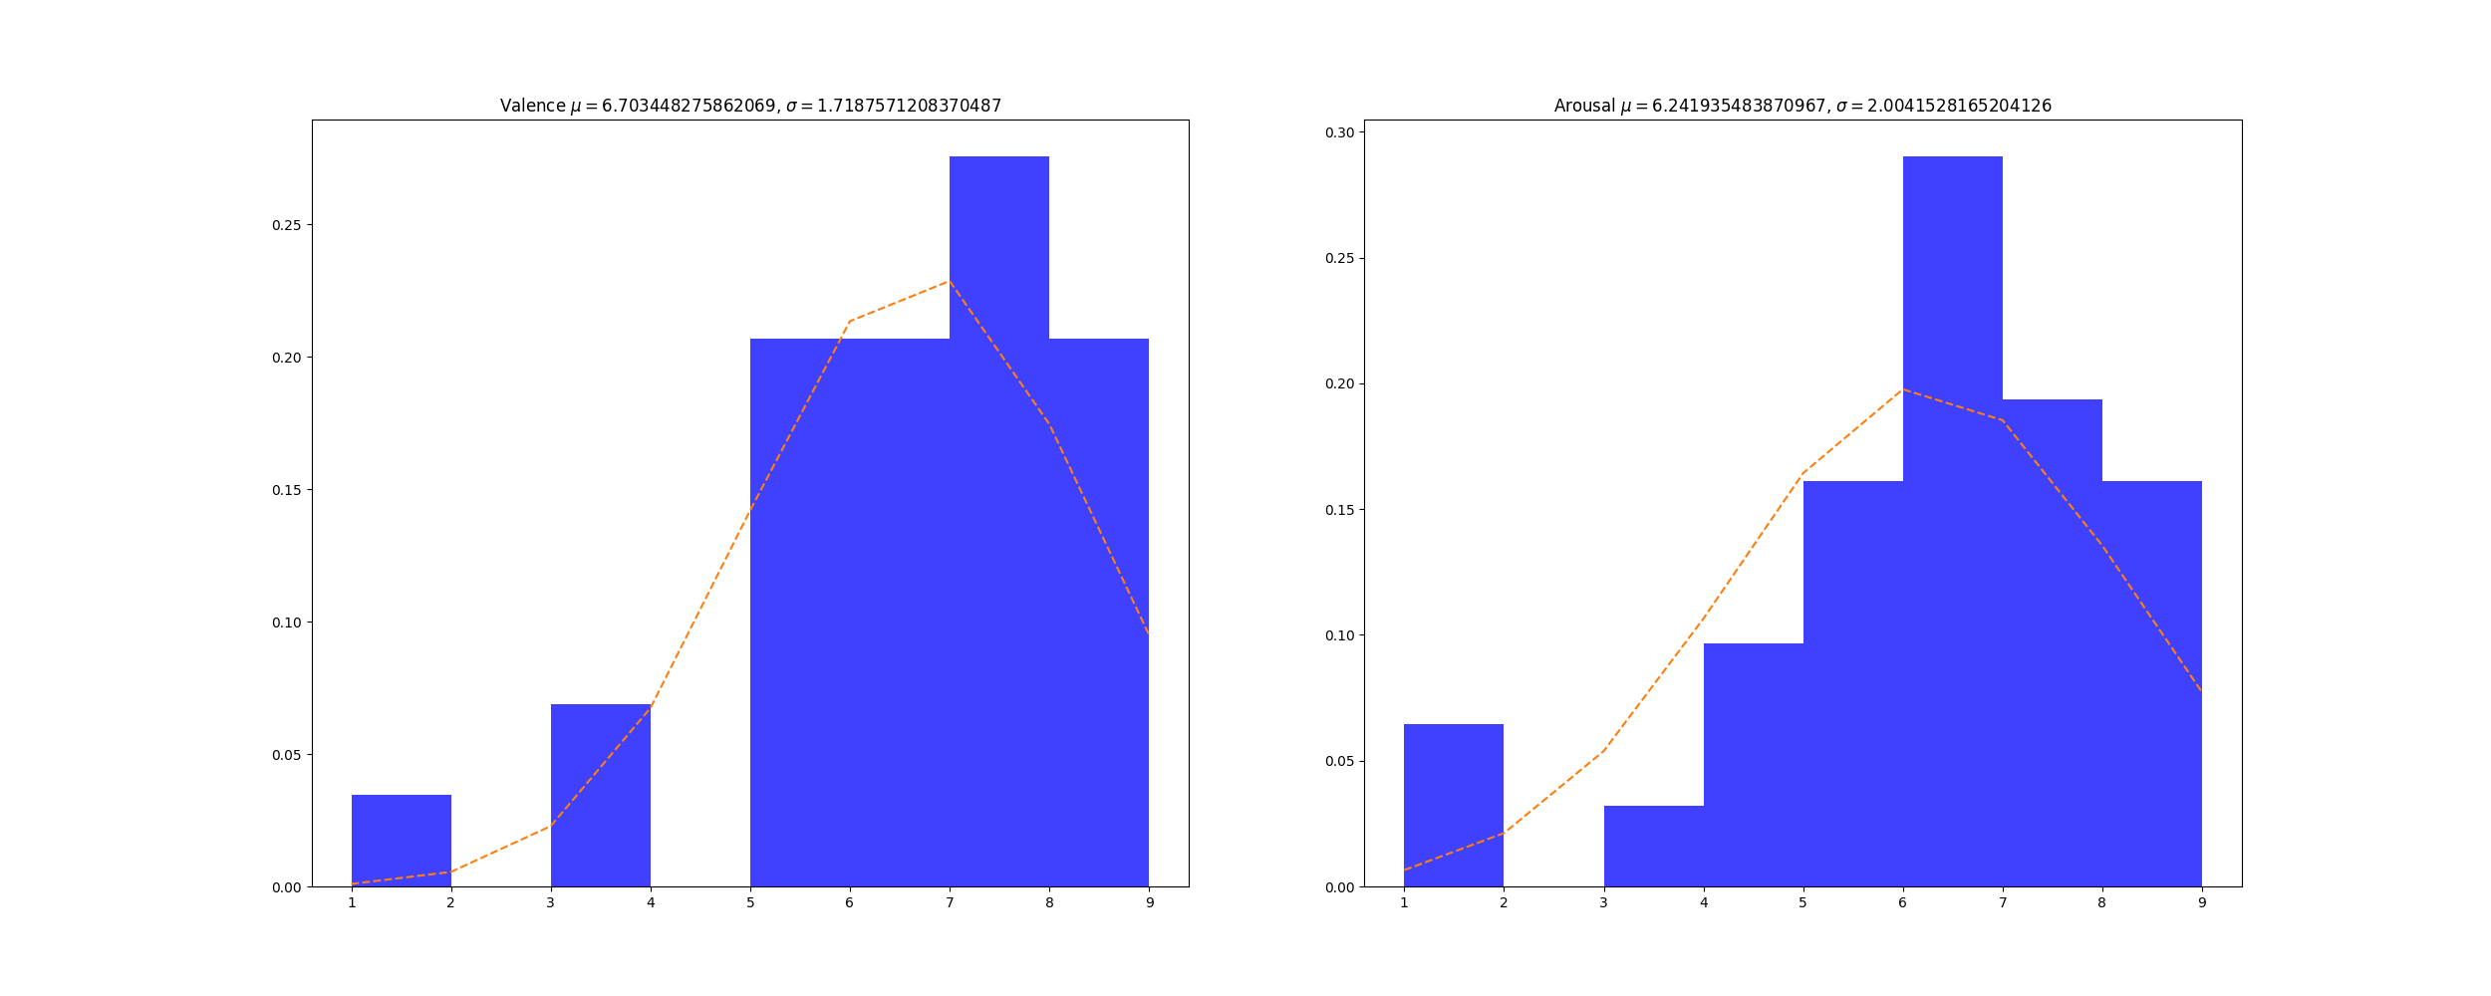
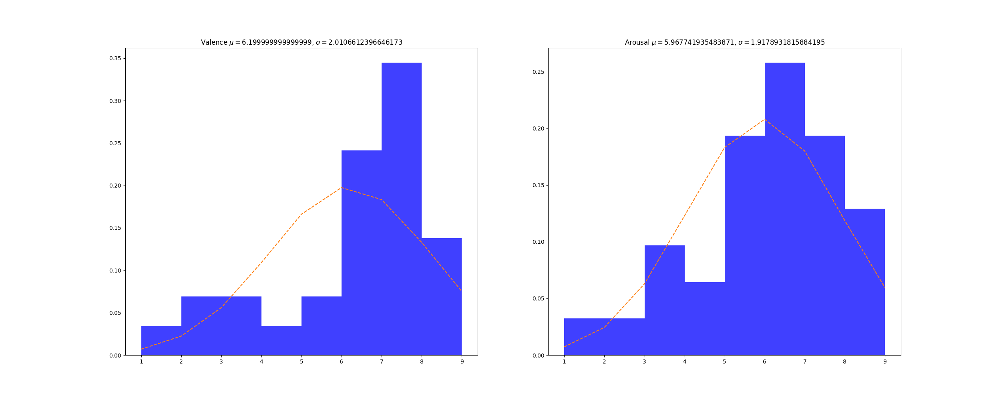
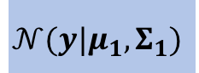
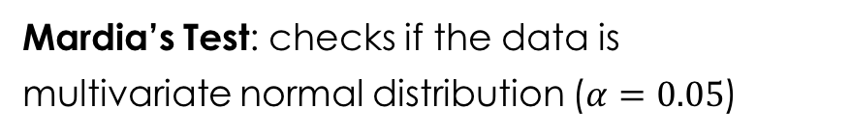
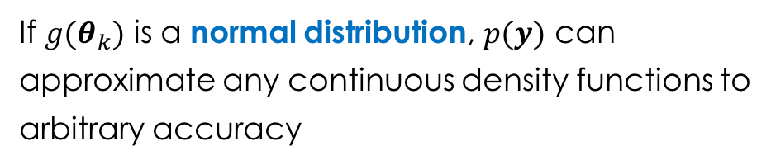
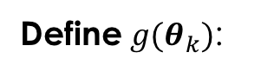
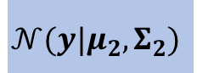
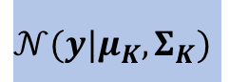
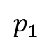
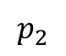
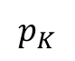
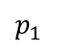
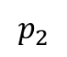
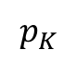
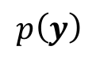
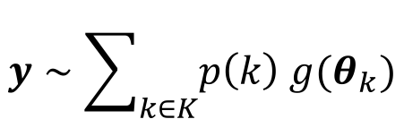
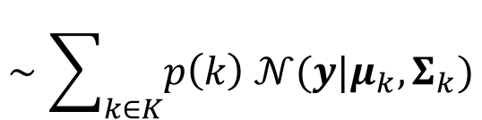
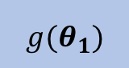
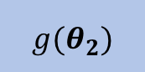
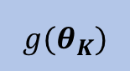
Methodology – Overview
Gaussian Mixture Model (GMM)
$$y∼\sum_{k∈K}{p\left(k\right) g(θ_{k})}$$
Emo 1
Emo 2
…
Emo K
$$∼\sum_{k∈K}{p\left(k\right) 𝒩(y|μ_{k}, Σ_{k})}$$
$$p_{1}$$
$g(θ_{1})$
$$p_{2}$$
$g(θ_{2})$
$$p_{K}$$
$g(θ_{K})$
$$p_{1}$$
$$𝒩(y|μ_{1}, Σ_{1})$$
$$p_{2}$$
$$𝒩(y|μ_{2}, Σ_{2})$$
$$p_{K}$$
$$𝒩(y|μ_{K}, Σ_{K})$$
Define $g(θ_{k})$:
$$p\left(y\right)$$
Advantage:
Mardia’s Test: checks if the data is multivariate normal distribution ($α=0.05$)
If $g(θ_{k})$ is a normal distribution, $p(y)$ can approximate any continuous density functions to arbitrary accuracy
72% of the VA ratings passed Mardia’s Test
It is adequate to assume VA ratings are bivariate normal distr.
Notes:
Suppose for a given statement, we have k possible emotions. For each possible emotion, we define g(\theta) as its distribution with corresponding emotion probability.
Now the first task of our research is that if we want to the get exact values of probability of y, we need to define the clear form of g(\theta)
We observed the data, and found that on each dimension, they are likely can be described by normal distribution. To verify this, we conducted a multivariate normal distribution test on our data. The results show that …
We also found that If $g(θ_{k})$ is a normal distribution, $p(y)$ can approximate any continuous density functions to arbitrary accuracy
So we just define $g\left(θ_{k}\right)$ as normal distribution with parameters \mu and \Sigma, and then combine them, get p(y), that is the emotion distribution

Slide 22
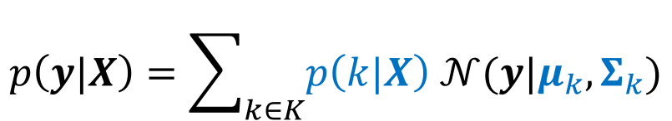
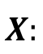
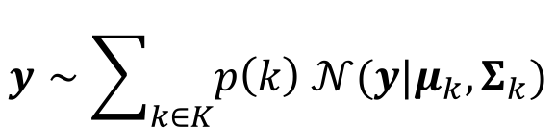
Methodology – Overview
Problem Definition
Given a statement, provide the emotion distribution in VA space
Arousal
Thanks for the birthday wishes everyone!!!
Turns to a parameter estimation problem
Valence
emotion prob. and Gaussian parameters are to be estimated
$$X:$$
features of texts
$$y∼\sum_{k∈K}{p\left(k\right) 𝒩(y|μ_{k}, Σ_{k})}$$
$$p\left(y|X\right)=\sum_{k∈K}{p\left(k|X\right) 𝒩(y|μ_{k}, Σ_{k})}$$
Emotion classifier
VA ratings
Notes:
Now let’s recall our goal of this research. For a given statement, we want to get the emotion distribution in VA space.
We define X as the features of texts. Thus, given X, we can get the clear form of EmoPredictor. This turns to a parameter estimation problem. The parameters to be estimated are emotion probability and Gaussian parameters \mu and \Sigma.
We can get Gaussian parameters from VA ratings. As to emotion probability, we obtain it through emotion classifier.

Slide 23
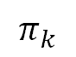
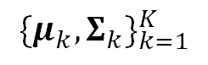
Methodology – Overview
Turns to a parameter estimation problem:
VA ratings
with specifying the form of distr.
$$π_{k}$$
$${\{μ_{k}, Σ_{k}\}}_{k=1}^{K}$$
emotion classification
VA ratings
without specifying the form of distr.
Notes:
This turns to a parameter estimation problem. The parameters to be estimated are…
Traditionally, all these three parameters can be obtained from VA ratings if we specify the form of pi_k
Instead of doing this, we proposed a aggregated model that integrates emotion classification into VA emotion model in which the distribution pi_k is not needed to specify.

Slide 24
Outline
Introduction
Related Work
Objective
Methodology
Modeling Assumptions
Framework
EmoPredictor Modeling with GMM
Experiment and Evaluation
Conclusion
Notes:
Now, in the following, I will introduce the framework of the predictive model and have a detailed look at how to predict text emotion in VA space by integrating emotion classification and VA emotion model.

Slide 25
Methodology – Framework of EmoPredictor
Social media data collecting
VA rating
GMM Modeling
GMM Modeling
GMM Prediction
GMM Prediction
Evaluation and Validation
Notes:
This is the framework of EmoPredictor.
We first collect data from social media. Because the predictive model is a pre-trained model, then we separate them into training dataset and testing dataset. Both these two datasets are rated by valence and arousal. After that, we will extract K possible emotions for the given texts. As illustrated before, based on the K possible emotions, we apply GMM to model EmoPredictor. This stage is called GMM modeling. The next stage is GMM prediction. With testing dataset, we will perform evaluation and validation with GMM prediction.

Slide 26
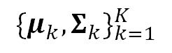
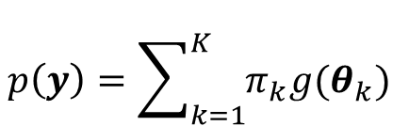
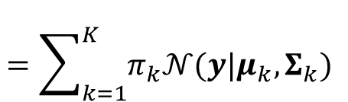
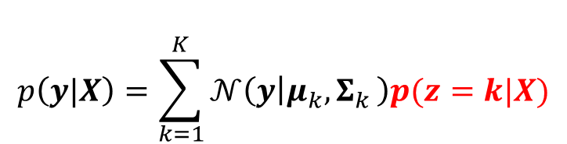
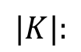
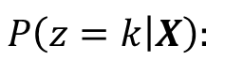
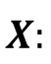
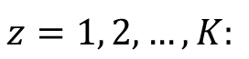
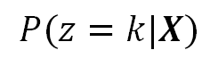
Methodology – GMM Modeling
Number of components (possible emotions)
Turns to a parameter estimation problem:
$$|K|:$$
$$X:$$
features of texts
$$P(z=k|X)$$
$${\{μ_{k}, Σ_{k}\}}_{k=1}^{K}$$
$$z=1, 2, …, K:$$
random variable
$$P\left(z=k | X\right):$$
the prob. of emotion k that a text belongs to
Given the features X of texts, the emotion distribution is described as:
$$p\left(y\right)=\sum_{k=1}^{K}{π_{k}g(θ_{k}) }$$
$$p\left(y|X\right)=\sum_{k=1}^{K}{𝒩\left(y | μ_{k}{,Σ}_{k}\right)p(z=k|X)}$$
Emotion probability
$$=\sum_{k=1}^{K}{π_{k}𝒩(y|μ_{k}, Σ_{k}) }$$
Notes:
Now we will discuss the modeling process in detail. Let’s look at GMM modeling first.
Suppose K is the number of possible emotions, X is the features of texts. In addition, we define z as a random variable that can be set to any inter number among 1 to K
Then we re-present the \pi_k as this: the probability of z equals to k given X. It means the probability of emotion k that a text belongs to.
Then,

Slide 27
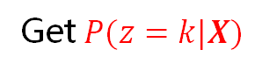
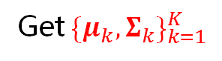
Methodology – GMM Modeling
Extract the possible emotions of texts
Get $P(z=k|X)$
For testing data:
Rate VA grouped by emotions
Extract possible emotions of texts
Locate each emotion at the likely position in VA space
Solve GMM model
Get ${\{μ_{k}, Σ_{k}\}}_{k=1}^{K}$
GMM prediction
Modeling part
Prediction part
Notes:
分解這個圖！

Slide 28
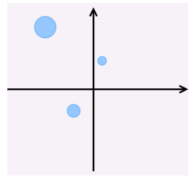









Methodology – GMM Modeling
$$p\left(y|X\right)=\sum_{k∈K}{p\left(k|X\right) 𝒩(y|μ_{k}, Σ_{k})}$$
Extract the possible emotions of texts
Obtain $P(k|X)$
VA rating
Rate VA grouped by emotions
rated
training
Locate each emotion at the likely position in VA space
Emo 1
$$p_{1}$$
Classification
Emo 2
$$p_{2}$$
Estimate GMM parameters
…
Obtain ${\{μ_{k}, Σ_{k}\}}_{k=1}^{K}$
Emo K
$$p_{K}$$
For testing data:
$$p_{1}$$
$$p_{2}$$
$$p_{K}$$
Emo 1
Emo 2
…
Emo K
VA ratings
Extract possible emotions of texts
Obtain $P\left(k | X\right)$ for testing data
Classification
Predict emotion distribution
testing
Evaluation
Notes:
分解這個圖！

Slide 29




Methodology – GMM Prediction
Combine possible emotions into a single emotion distribution with priors
Weighted
predicted model
$$μ_{pre}=\frac{p\left(z=k | X_{unseen}\right)μ_{k}}{\sum_{k=1}^{K}{μ_{k}}}$$
$$Σ_{pre}=\frac{p\left(z=k | X_{unseen}\right)Σ_{k}}{\sum_{k=1}^{K}{Σ_{k}}}$$
GMM Model
GMM Prediction
$${\{μ_{k}, Σ_{k}\}}_{k=1}^{K}$$
$$P(z=k|X)$$
from training data
from testing data
Notes:
分解這個圖！

Slide 30
Outline
Introduction
Related Work
Objective
Methodology
Modeling Assumptions
Framework
Emotion Prediction Modeling with GMM
Estimate Emotion Probability
Estimate Gaussian Parameters
Experiment and Evaluation
Conclusion

Slide 31

Methodology – Parameter Estimation
$$P(z=k|X)$$
Possible Emotion Extraction
Notes:
分解這個圖！

Slide 32

Methodology – Parameter Estimation
$$P(z=k|X)$$
Convolutional Neural Network (CNN)
word2vec
Emotion Classifier (EC)
emotion patterns
Random Forest (RF)
Multinomial Naïve Bayes (NB)
Bag-of-Word (BoW)
(TF-IDF)
Latent Dirichlet Allocation (LDA)
K-means
Notes:
TFIDF
word2vec
emotion patterns

Slide 33



Methodology – Parameter Estimation
Emotion Classifier
$$P(z=k|X)$$
8 emotions are classified with Emotion Classifier
Joy: 0.033
Sadness : 0.143
Anger : 0.136
.+ leave .+
.+ alone
Surprise : 0.044
NOTHING leave
me alone!!!!!!!!!!
……
Fear : 0.048
.+ !!!!
Disgust : 0.457
Anticipation : 0.070
$$P\left(z=k | X\right)= \frac{e^{−sk}}{\sum_{k=1}^{K}{e^{−sk}}}$$
Trust : 0.069
$$s_{k}:$$
the k-th emotion score
[Argueta, Carlos etc., 2015]

Slide 34


Methodology – Parameter Estimation
K-means/LDA
$$P(z=k|X)$$
K-means
$$P\left(z=k | X_{t}\right)= \frac{1/d_{k}}{\sum_{k=1}^{K}{\frac{1}{dk}}}$$
$$d_{k}:$$
the distance from text t to the k-th cluster center
Notes:
分解這個圖！

Slide 35




Methodology – Parameter Estimation
$${\{μ_{k}, Σ_{k}\}}_{k=1}^{K}$$
Expectation-Maximization (EM) Algorithm
Iteratively calculate $μ_{k}$and $Σ_{k}$
Notes:
分解這個圖！

Slide 36
Outline
Introduction
Related Work
Methodology
Experiment and Evaluation
Data Collection and Processing
Possible Emotions Extraction
Model Evaluation
Prediction Evaluation
Conclusion

Slide 37

Methodology – Data Collection and Processing
Select typical social media texts
Daniel Preotiuc-Pietro, etc. Modelling valence and arousal in facebook posts. In Proceedings of NAACL-HLT, pages 9–15, 2016.
Each text has been rated by two professional annotators
Inner-annotator agreement Kappa $κ=0.93$
Selection Criteria
Difference of two annotators ratings on valence and arousal less than 2
Eight emotions
Joy, anger, sadness, disgust, fear, surprise, anticipation, trust
Notes:
We utilize a publicly released Facebook dataset as our research data. In this data, each text is rated by two professional annotators.
We first calculate the difference of two annotates ratings on valence and arousal. We only keep the text whose difference is less than 2.
Then we let annotators to label the text among eight emotion candidates.

Slide 38


Methodology – Data Collection and Processing
Each text is rated with valence and arousal by different annotators
Slider bars are used to rate valence and arousal independently
Range:
Valence : 1~9
Arousal : 1~9
[Alberto Betella etc., 2016]

Slide 39
Experiment – Data Collection and Processing
Data collection is conducted on Amazon Mechanical Turk (AMT)
147 texts, each of which is rated by 30 different annotators
Range:
Valence : 1~9
……
…
Arousal : 1~9
147 texts
30 annotators
[Alberto Betella etc., 2016]
Notes:
In the end, 147 texts are selected to model EmoPredictor.
These data are then sent to Amazon Turk. Each text is rated with valence and arousal by 30 different annotators.
We also designed an interface to assist the annotators to rate.

Slide 40










Experiment – Data Collection and Processing
Outlier Detection
$$\left({\overline{x}}_{v},{\overline{x}}_{a}\right)=(\frac{1}{n}\sum_{i=1}^{N}{v_{i}, }\frac{1}{n}\sum_{i=1}^{N}{a_{i}})$$
A rating pair $\left(v_{i},a_{i}\right)$ is an outlier if:
$$d_{i}=\sqrt{{\left(v_{i}−{\overline{x}}_{v}\right)}^{2}+{\left(a_{i}−{\overline{x}}_{a}\right)}^{2}}$$
$$d_{i}>2σ_{d}$$
$$σ_{d}=\sqrt{\frac{\sum_{i=1}^{N}{{\left(d_{i}−\overline{d}\right)}^{2}}}{n−1}}$$
$$\overline{d}= \frac{1}{n}\sum_{i=1}^{N}{d_{i}}$$
Notes:
once we get the VA ratings, we found there are some outliers.
We remove the outliers by the following equations.

Slide 41



Experiment – Possible Emotion Extraction
Texts classification and clustering for
$$p(k|Xt)$$
Type | Method | Features | |K|
Supervised | Emotion Classifier | Emotion Patterns | 8
 | Random Forest | BoW | 8
 | CNN | Word Embedding | 8
 | Naïve Byes | BoW | 8
Unsupervised | LDA | BoW | 8, 14
 | K-means | BoW | 8, 14
$$P\left(z=k | X\right)= \frac{e^{−sk}}{\sum_{k=1}^{K}{e^{−sk}}}$$
$$P\left(z=k | X_{t}\right)= \frac{1/d_{k}}{\sum_{k=1}^{K}{\frac{1}{dk}}}$$
Notes:
And then we utilize several emotion classifiers to extract the possible emotions.
We employ six emotion classification methods. Four of them are supervised and two are unsupervised. The emotion classifier is based on emotion patterns, which is a sequence of symbols, like words, punctuations and so on. Its output is eight emotions with eight scores. We use this calculation to convert the emotion score to emotion probability.
Similarly, K-means outputs the distance between the text and the its nearest cluster center. We use this calculation to convert the distance to emotion probability.

Slide 42
Experiment – GMM Model Results
fear
anger
anticipation
disgust
surprise
Generally, trust, anticipation, surprise, joy have high valence and high arousal
joy
trust
Sadness, anger, disgust and fear have low valence
sadness
Notes:
This is an example of the emotion locations in VA space. We can separate these eight emotions into positive emotions and negative emotions.
Trust, anticipation, surprise and joy have high valence and high arousal. We can treat them as positive emotions.
The remainder four emotions have low valence. They are negative emotions.
We can see that sadness is assumed in low arousal and the other three emotions in high arousal.

Slide 43

Experiment – GMM Model Results
Nearly all emotions are correctly classified in valence dimension
Surprise
Less accurate in classifying on arousal dim.
Surprise
Different classifiers locate emotions in different positions
Surprise
Notes:
This is the model results of supervised classification.

Slide 44

Experiment – GMM Model Results
Unsupervised methods poorly distinguish emotions
Largely overlapped
Increasing K may increase coverage
Unsupervised methods are not as good as supervised but training data are not necessary
Notes:
This is the results of unsupervised methods.
As what the results show, the emotion distributions are different in different methods. To verify the performance of each emotion classifier, we develop a measurement.

Slide 45




Experiment – GMM Model Results
Emotion Classifier
RandomForest
CNN
Method
Emotion Classifier | Emotions in right positions; anger in low arousal; joy, anticipation and surprise are largely overlapped
RandomForest | Anger and disgust overlapped; surprise in wrong direction; fear in wrong position
CNN | Overlapped, emotions in wrong positons
NB | Anger and disgust’s positions are opposite to EC
NB

Slide 46



Experiment – GMM Model Results
Kmeans 8
LDA 8
Largely overlapped
Largely overlapped
Largely overlapped
Unsupervised methods are poorly distinguish emotions
Position of K12 is not detected by other methods
Notes:
What is K12?

Slide 47

Experiment – GMM Model Results
Average Emotion Distance (AEmoD)
The greater distance, the more distinguishable for components
$$AEmoD= \frac{1}{2}K(K−1)\sum_{i≠j}^{K}{∥μ_{i}−μ_{j}∥}$$
EC has the highest AEmoD
LDA8 has the lowest
Increasing K increases AEmoD
Notes:
We calculate the average emotion distance for each classifier according to this equation. The greater distance, the more distinguishable for the emotions. That is, the greater, the better. Because we hope the emotions separate from each other in VA space. Resutls shows that EC has the highest AEmoD and LDA8 has the lowest. We also found that increasing K can also increase the distance.

Slide 48
Experiment – GMM Prediction Results
Leave-one-out validation
Makes the number of testing data as the same as that of training data
anticipation
Generally, trust, anticipation, surprise, joy has high valence and high arousal
trust
Sadness, anger, disgust and fear have low valence
Notes:
The previous results show how good the model is. Now let’s look at the performance of prediction results.
We run leave-one-out validation on the data so each text can be verified.
Recall the emotion location picture.

Slide 49






Experiment – GMM Prediction Results
Some Examples
EC
We hope:
Predicted emotion distribution covers as many as ratings
joy
sadness
anger
Position of predicted emotion close to direct observations
CNN
Two methods to evaluate the prediction
joy
sadness
anger
Notes:
Here are some examples of the prediction. For the same text, we can see that the predicted emotion distribution vary from each other by employing different methods.
We hope the predicted emotion distribution covers as many as ratings and the position is close to direct observations, that is the ratings that rated by annotators.
We use two methods to evaluate the performance of prediction.

Slide 50





Methodology – Evaluation
Prediction Evaluation (1/2)
Kullback-Leibler divergence (KL divergence)
$$g_{B}\sim 𝒩(μ_{B}, Σ_{B})$$
similarity between two probability distributions
$$g_{A}\sim 𝒩(μ_{A}, Σ_{A})$$
$$D_{KL}(g_{A}|\left|g_{B}\right)=\sum_{i}{g_{A}\left(i\right)\ln{\frac{g_{A}(i)}{g_{B}(i)}}}$$
Predicted distr.
Direct Obn’s
$$g_{A}\sim 𝒩(μ_{A}, Σ_{A})$$
$$g_{B}\sim 𝒩(μ_{B}, Σ_{B})$$
GMM Model
GMM Prediction

Slide 51






Methodology – Evaluation
Prediction Evaluation
$$g_{B}\sim 𝒩(μ_{B}, Σ_{B})$$
$$g_{A}\sim 𝒩(μ_{A}, Σ_{A})$$
Kullback-Leibler divergence (KL divergence)
similarity between two probability distributions
$$D_{KL}(g_{A}|\left|g_{B}\right)=\sum_{i}{g_{A}\left(i\right)\ln{\frac{g_{A}(i)}{g_{B}(i)}}}$$
GMM Model
GMM Prediction
Predicted distr.
Direct Obn’s
Covariance considered
$$g_{A}\sim 𝒩(μ_{A}, Σ_{A})$$
$$g_{B}\sim 𝒩(μ_{B}, Σ_{B})$$
Euclidean Distance (ED)
distance between predicted mean vectors and direct observations mean vectors
$$ED_{AB}=|\left|μ_{A}−μ_{B}\right||$$
Covariance not considered
Notes:
The first one is KL divergence. It measures the similarity between two probability distributions. g(A) is predicted emotion distribution and g(B) is direct observations. KL divergence is calculated by this equation.
The other measurement is Euclidean distance. It is the distance between predicted mean vectors and direct observations mean vectors.
KL divergence considers both means and covariance but ED only considers means.
Both of the two measurements, we hope the smaller, the better.

Slide 52
Experiment – GMM Prediction Results
Leave-one-out cross validation
Average KL divergence (AKL)
Average Euclidean Distance (AED)
Notes:
For leave-one-out cross validation, because each sample can be evaluated, we take average of KL and ED as the overall performance.
the results show that EC has the best performance on both AKL and AED.
It also shows that for K-means, increasing K will improve AKL. However, for LDA, it doesn’t.

Slide 53





Experiment – GMM Prediction Results
trust
EC
trust
RF
trust
CNN
trust
NB
Notes:
Now let’s see the performance of each emotion.
This is the predicted emotion distribution for each text that belongs to trust.

Slide 54





Experiment – GMM Prediction Results
Leave-one-out validation
anticipation
EC
anticipation
RF
anticipation
CNN
anticipation
NB
Consistency direction
Notes:
These are the results of anticipation.
Their direction are in consistency, following the diagnal.

Slide 55





Experiment – GMM Prediction Results
surprise
EC
surprise
RF
surprise
CNN
surprise
NB
EC:
Higher valence and higher arousal
Notes:
This is surprise. EC has higher valence and higher arousal compared to other methods. And it seems EC has an outlier.

Slide 56





Experiment – GMM Prediction Results
joy
EC
joy
RF
joy
CNN
joy
NB
Notes:
This is joy.

Slide 57





Experiment – GMM Prediction Results
sadness
EC
sadness
RF
sadness
CNN
sadness
NB
Sadness has big variance on arousal dimension
EC and RF reveal the low-arousal property
Notes:
This is sadness. Sadness has variance on arousal dimension. EC and RF locate these texts in the left-down area.

Slide 58





Experiment – GMM Prediction Results
anger
EC
anger
RF
anger
CNN
anger
NB
Vertical direction
Anger has big variance on both arousal and valence
But EC and RF are able to classify anger on valence
Notes:
This is anger. We can see that some predicted emotion distributions have vertical direction. Anger has big variance on both valence and arousal.
EC , RF and NB basically classify anger correctly on valence dimension.

Slide 59





Experiment – GMM Prediction Results
disgust
EC
disgust
RF
disgust
CNN
disgust
NB
Ratings are similar to anger
EC: higher arousal
CNN: higher valence
Notes:
This is disgust. The disgust ratings are similar to anger.

Slide 60





Experiment – GMM Prediction Results
fear
EC
fear
RF
fear
CNN
fear
NB
Notes:
This is fear

Slide 61
Experiment – GMM Prediction Results
Though the variance of ratings is high, EmoPredictor can still catch the expected position
Joy, surprise, anticipation and trust are high valence
Disgust is low valence and high arousal (anger cover high arousal partly)
Sadness is low valence and low arousal
Most of the predictions with expected direction
What roles do the classifiers play?
Does accuracy of classifier matter?

Slide 62
Experiment – GMM Prediction Results
Classification performance and prediction performance of CNN
CNN
Though CNN cannot detect surprise,
it still shows the expected trend in prediction
surprise

Slide 63
Experiment – GMM Prediction Results
Classification performance and prediction performance of EC and NB
disgust
EC
disgust
NB
Naïve Bayes performs better than Emotion Classifier on disgust
But the prediction of Naïve Bayes is not what we expect

Slide 64
Experiment – GMM Prediction Results
Classification performance (overall)
Prediction performance (overall)
Naïve Bayes: higher classification performance, lower prediction performance
If a text is misclassified, it still could be correctly predicted by combining ratings distribution and emotion probability

Slide 65
Experiment – GMM Prediction Results
Leave-one-out validation
Emotion Classifier
trust
joy
surprise
anticipation
anger
disgust
fear
sadness

Slide 66
Methodology – Evaluation
GMM Fitting
GMM Prediction
Is the fitting good?
Does the prediction fit direct observations well?
Model Evaluation
Prediction Evaluation

Slide 67








Experiment – GMM Prediction Results
Emotion Classifier
Emotions with sentiment polar perform well
joy
joy
sadness
sadness
surprise
anticipation
anticipation
surprise

Slide 68








Experiment – GMM Prediction Results
Emotions with arousal polar are less distinguishable
anger
anger
disgust
disgust
fear
fear
trust
trust

Slide 69

Experiment – GMM Prediction Results
VA Rating Behaviors
influenced by the rating interface
influenced by idiographic personalities
People have polar feelings on negative emotions
Extroversion
Agreeableness

Slide 70
Conclusion
A parametric model is proposed for quantifiably analyze emotions
Integrate a deterministic emotion classifier into a parametric model
Not only one emotion is provided but also the potential emotions and trend with strength are available
Flexible and Scalable
Emotion Probability can be replaced by any classifiers
|K| can be increased
Balances misclassification problem and divergence ratings problem
Reduces the influence of misclassification and divergence ratings at the same time

Slide 71
Conclusion
VA Rating Behaviors
For positive emotions, people tend to rate higher valence in combination with higher arousal
For negative emotions, ratings are in variance on arousal dimension by individual

Slide 72
Thank you.

